Slide 1
Recap of Lesson 1
We covered:
Parallel processing is a way of running code at the same time
Using the multiprocessing library to implement parallel processing
Using .start() and .join() to run and wait for a function
Using args=[] to pass arguments to a function

Slide 2
Returning values
with Parallel Processing

Slide 3
How many failed files?
Checking how many files weren’t loaded in the function
def load_music_files(music_files, message_to_print):
time.sleep(1) # simulate loading music_files…
print(message_to_print)
unloaded_files = ['Halaila.mp3', 'A little bird.mp3']
return unloaded_files
my_music = ['Et Rekod.mp3', 'Halaila.mp3', 'A Yid.mp3', 'Utzu Eitzah.mp3', 'A little bird.mp3']
load_first_half = multiprocessing.Process(target=load_music_files, args=[my_music[:2], 'First half loaded!'])
load_second_half = multiprocessing.Process(target=load_music_files, args=[my_music[2:], 'Second half loaded!'])
load_first_half.start()
load_second_half.start()
load_first_half.join()
load_second_half.join()
>>> First half loaded!
>>> Second half loaded!
Why can’t the function return a value?
Notes:
Let’s try returning a value from our load_music_files function

Slide 4





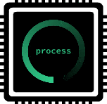


Communication
How we usually interact with a function
main program
parameters
parameters
parameters
return values
function
main program
return values
multiprocessing
function
How we interact with a function with multiprocessing
return values
Notes:
So how can we receive data from the function?

Slide 5

The solution: Sending a pre-addressed envelope
main program
parameters
pre-addressed envelope
Return to: Sender
pre-addressed envelope
parameters
Return to: Sender
function
Return to: Sender
pre-addressed envelope
pre-addressed envelope
Return to: Sender
multiprocessing
Notes:
Just like we send parameters as arguments in the processor, we can send a pre-addressed envelope. The function can insert whatever it likes and we can open up the envelope to see what’s inside when we get it back.

Slide 6

Pre-addressed envelope: A code example
Using multiprocessing.Value to save data instead of returning from a function
import multiprocessing
def multiply_number(number, preaddressed_envelope):
multiplied_number = number * 2
preaddressed_envelope.value = multiplied_number
return
preaddressed_envelope = multiprocessing.Value('i')
print(preaddressed_envelope.value)
test = multiprocessing.Process(target=multiply_number, args=[4, preaddressed_envelope])
test.start()
test.join()
print(preaddressed_envelope.value)
💡?
Notice that we’re not returning data from the function in the regular way of return multiplied_number.
>>> 0
>>> 8
Notes:
This is the function multiply_number. It’s asking for a number parameter, and a preaddressed_envelope parameter
Create a new variable called multipled_number and set its value as the original parameter number * 2
Set the value of the pre-addressed envelope to hold the multiplied number
Return the function
In the base program: Create an instance of a pre-addressed envelope and set it to hold an integer
Print out the value to see what it holds
Create the process that will run the function in another core and pass the number and the pre-addressed envelope
Start and wait for the function
Print the value in the pre-addressed envelope to see what it holds

Slide 7
multiprocessing.Value object types
Type code | C Type | Python Type
'b' | signed char | int
'B' | unsigned char | int
'u' | wchar_t | Unicode character
'h' | signed short | int
'H' | unsigned short | int
'i' | signed int | int
'I' | unsigned int | int
'l' | signed long | int
'L' | unsigned long | int
'q' | signed long long | int
'Q' | unsigned long long | int
'f' | float | float
'd' | double | float
Types to pass in to a Value object
Source: array — Efficient arrays of numeric values — Python 3.11.1 documentation

Slide 8
Pre-addressed envelope: back to the MP3
def count_music_files(music_files_amt, preaddressed_envelope):
for _ in range(music_files_amt):
preaddressed_envelope.value += 1
return
preaddressed_envelope = multiprocessing.Value('i')
count_first_half = multiprocessing.Process(target=count_music_files, args=[50000, preaddressed_envelope])
count_second_half = multiprocessing.Process(target=count_music_files, args=[30000, preaddressed_envelope])
count_first_half.start()
count_second_half.start()
count_first_half.join()
count_second_half.join()
print(f'Total number of music files: {preaddressed_envelope.value}')
>>> 50728
⬅ Why are the numbers all wrong?
>>> 50360
>>> 50140
Notes:
One second, why are the numbers so strange? A new problem: we solved the data returning problem but now we have an issue with the return values. They aren’t correct.

Slide 9


What’s happening to the file counter?
The problem with using shared memory
Shared memory (AKA pre-addressed envelope)
Process 1’s copy
Process 2’s copy
Process 1: count_music_files
Process 2: count_music_files
0
1
0
1
0
1
Get shared value
Add 1
Update shared value
❓❓❓
Get shared value
Add 1
Update shared value
💡?
This value should be 2 by the time we’re done processing!
Notes:
When more than one process accesses the same object, they can overwrite each other’s changes.

Slide 10


Locking the object to prevent overwriting
Shared memory (AKA pre-addressed envelope)
Iterating…
Iterating…
Process 1: count_music_files
Process 2: count_music_files
Get shared value
Add 1
Update shared value
Get shared value
Add 1
Update shared value
2
0
1
What’s the problem here?
The functions have to take it in turns waiting for each other to finish editing the object. It’s not parallel processing any more!
How can we fix this?
Notes:
The solution is to use a lock to enable multiple functions to edit the same object. But this creates a new problem: it’s not parallel processing.

Slide 11
Locking the object: A code example
def count_music_files(music_files_amt, preaddressed_envelope):
total = 0
for i in range(music_files_amt):
total += 1
with preaddressed_envelope.get_lock():
preaddressed_envelope.value += total
preaddressed_envelope = multiprocessing.Value('i')
count_first_half = multiprocessing.Process(target=count_music_files, args=[50000, preaddressed_envelope])
count_second_half = multiprocessing.Process(target=count_music_files, args=[30000, preaddressed_envelope])
count_first_half.start()
count_second_half.start()
count_first_half.join()
count_second_half.join()
>>> 80000
Notes:
Solving the problem of not parallel processing when using a lock by moving the lock out of the function loop so that it only executes once.

Slide 12
Lesson Overview
Use the multiprocessing library
Return a value from a function with multiprocessing.Value
Lock the shared value using Value.get_lock()

Slide 13
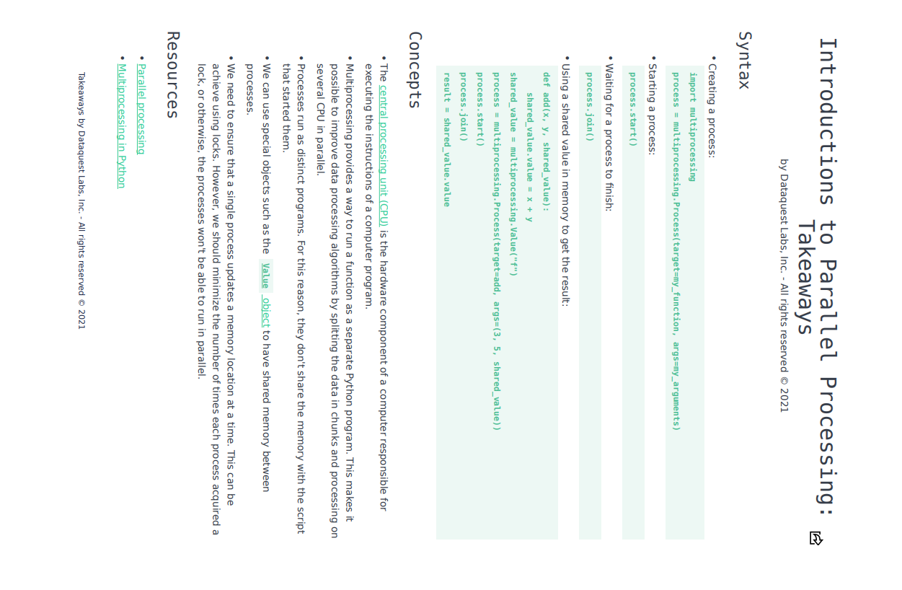
Intro to Parallel Processing: Takeaways

Slide 14
Parallel Processing: Cheatsheet

Slide 15
Classwork
At the top of your submitted file, make a note of the help you used or the extra brownie points you completed. For example: Used the step by step for Challenge 1. Managed steps 1-3 of extra brownie points for Challenge 1.
Challenge 1:
Dataquest: Introduction to Parallel Processing
Complete steps 7 - 9
Extra brownie points: Follow the steps from Slide 14 instead of the Dataquest step-by-step instructions.
Challenge 2:
Write a (not multiprocessing) function that accepts two numbers and returns their product. For example, inputting 5 and 3 would return 15.
Call the function with at least two processes, and use a pre-addressed envelope with a lock to return the value.
Challenge 3:
Write a Vault class where you can keep the cash value of your different savings accounts.
It should have at least four processes
You should be able to create new accounts and see how much all or some of the accounts are worth together
Use multiprocessing!

Slide 16
Extra brownie points for Challenge 1
Dataquest: Introduction to Parallel Processing (Instructions)
Read Dataquest up until the instructions and then follow these instructions instead.
7. Sharing Memory: Create a shared value (pre-addressed envelope) called float_value, of type float. Change sum3 to save the sum of 3 numbers inside the shared value. Run sum3 with a process.
8. Sharing Memory Caveats: Call sum_with_two_processes() 10 times and store the results in a list called results, then print the list.
9. Using a Lock: Create a function called sum_values_improved() which accepts a first, last, and shared_value parameter. Count the difference between first and last, using a loop, and assign it to the shared value using a lock. Measure the runtimes of sum_values and sum_values_improved and save them in time_sum_values and time_sum_values_improved respectively.

Slide 17
Homework
Link for quiz: https://forms.gle/gDWUtf8Qded4JE6w8
Finish the Vault Challenge 3
Note: Keep things very simple because we haven’t yet learned the things we need to know in order to make things fancy!

Slide 18
Step by step instructions for Challenge 3
WITHOUT THINKING ABOUT PARALLEL PROCESSING:
1. Create a class called Vault
2. Your class should have methods to create accounts, get the amounts that the accounts are holding, etc
3. Test out your Vault program.
NOW START THINKING ABOUT PARALLEL PROCESSING:
1. Create two bank accounts, using parallel processing
Note: check if your create method is returning
anything. If it's not, you DON'T need to use a preaddressed envelope.
2. Read your bank account values and save them as a total. Use parallel processing.
Note: check if your read method is returning
anything. If it is, you DO need to use a preaddressed envelope.

